Slide 1
WISE Buyer versus Conspicuous Consumer

Slide 2
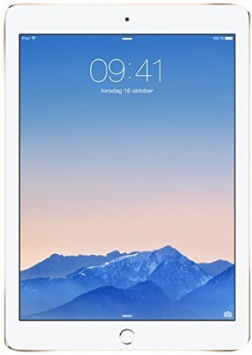
Conspicuous Buy: Ipad Air
Apple iPad Air 2 (64GB)
Price: $554
Why is it conspicuous?
The Ipad is the most wanted tablet in the market
Why is it expensive?
This Ipad has 64gb and is the newest model

Slide 3
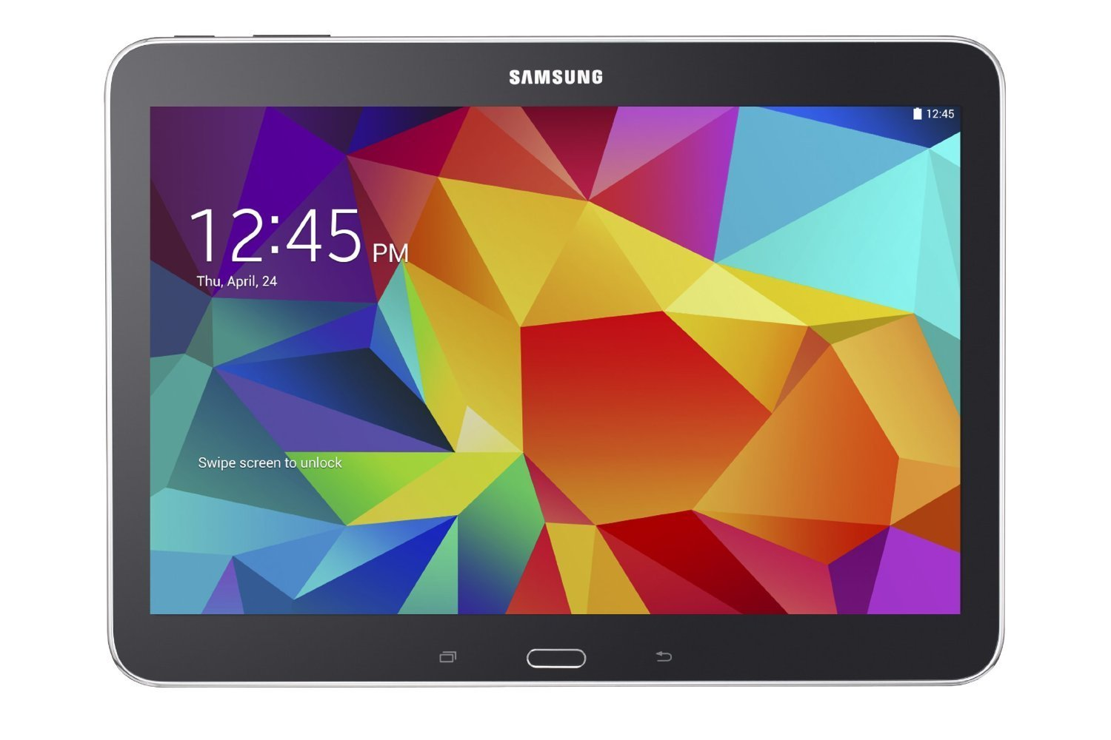
Wise Buy: Samsung Galaxy
Samsung Galaxy Tab 16gb
Price: $244.99
Why is it WISE?
This tablet is cheaper but has similar functions
I sacrifice GB space but I don’t need them

Slide 4
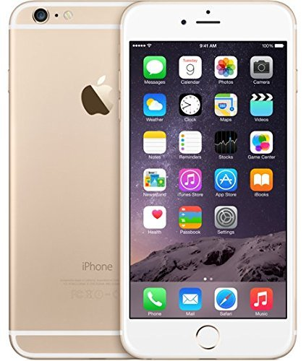
Conspicuous Buy: IPhone
Iphone 6 (128GB)
Price: $865.00
Why is it conspicuous?
People want iphone now days.
Why is it expensive?
This Iphone has 128gb and is the newest model.

Slide 5
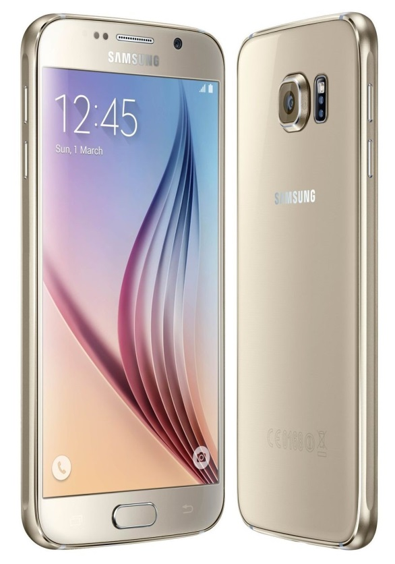
Wise Buy: Galaxy s6
Samsung Galaxy s6 32gb
Price: $579.00
Why is it WISE?
This galaxy s6 is cheaper but has similar functions
I sacrifice GB space but I don’t need them

Slide 6
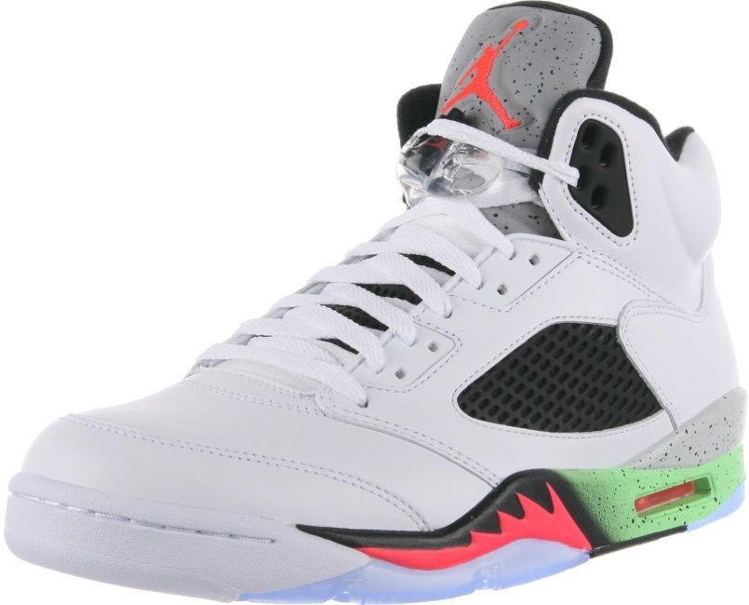
Conspicuous Buy: Jordan
New Jordan
Price $300.00
why is it conspicuous?
Jordan is the most wanted shoes in the market.
Why is it expensive?
They cost so much because you're not just buying any basketball shoe but a shoe that revolutionized basketball shoes everywhere

Slide 7
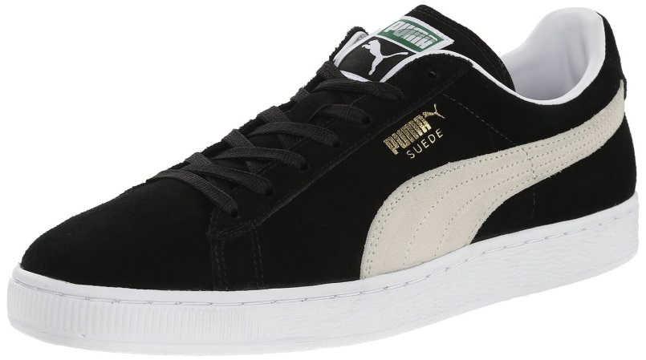
Wise Buy: Puma
Puma shoe
Price $30.00
Why is it WISE?
This shoe is cheaper but it look nice.

