Slide 1
Financial Goals
Engineering is my career I want to be in the future. I want this career because I'll have the power to make a difference! By becoming an engineer, I can help solve problems that are important to society. I could be controlling and preventing pollution, developing new medicines, creating advanced technologies, even exploring new worlds. I will make $146,770 per year.

Slide 2
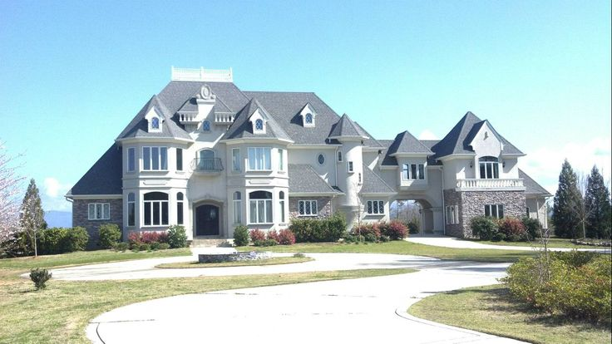
Long-Term House goals
I will buy a house
I will live Atlanta GA
My mortgage will be about 13,000

Slide 3
Long-Term Goal #3
Buy a car
Car is important to me because car provide a common means of transportation, whether it is a longer commute to work or a shorter trip to run errands around town.
My car cost $83,495

