Slide 1
Credit Card Comparison
By Kezia Kusi Appouh

Slide 2
Instructions:
Research 10 Credit Cards -go to www.nerdwallet.com/credit-cards
Choose one credit card from each category
Complete the information
Make into PDF
Upload to your website

Slide 3
CITI THANK YOU PREMIER CARD
This is a REWARDS CARD
Annual Fee: you pay $95 a year, but the first year is free
Rewards: 1 point per dollar
APR: Variable %14-23
Introductory APR: N/A
BALANCE TRANSFER: N/A
Why would you want this card?
This card offers you good points for making purchases. It’s a good rewards card. However, there is a fee and the interest rate is high.

Slide 4
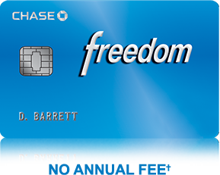
Chase Freedom(R)
This is Low Interest Card
Signing Promotion
Earn a $100 Bonus after you spend $500 on purchases in your first 3 months from account opening
Reward Rate
1.00%* question
Annual Fee
$0
APR, Variable
APR: 13.99%-22.99% (Variable) Cash Advance APR: 24.99%, Variable
Intro APR Promotions
0% for 15 Months on purchases and 0% Intro APR for 15 months on balance transfers

Slide 5
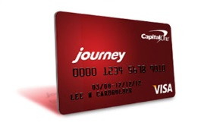
Journey® Student Rewards from Capital One®
This is Student Card
Earn 1% cash back on all purchases, plus a 25% bonus on the cash back you earn each month you pay on time, for a total of 1.25% cash back
There’s no limit to the amount of cash back you can earn, and rewards don't expire
Get access to a higher credit line after making your first 5 monthly payments on time
Pay no annual or foreign transaction fees
Fraud coverage if your card is lost or stolen
Pick the monthly due date that works best for you
Free access to your credit score and learn how everyday decisions can affect your score using Capital One® Credit Tracker

Slide 6
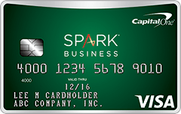
Capital One® Spark® Cash for Business
This is Business Card
Earn 2% cash back on every purchase, every day
Plus, a one-time $500 cash bonus once you spend $4,500 on purchases within the first 3 months
Cash rewards don't expire, and there are no categories to limit where or what you buy
$0 intro annual fee for the first year; $59 after that
Redeem cash rewards anytime, for any amount, even set up automatic redemption
No foreign transaction fees
Earn unlimited cash rewards that don't expire

Slide 7
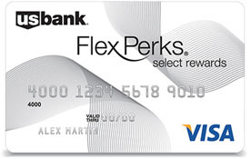
U.S. Bank Flex Perks® Select Rewards Visa® Card
This is TRAVEL CARD
Earn 10,000 bonus Flex Points after you spend $1,000 in Net Purchases within the first four months of account opening.
Earn One Flex Point for every $2 of eligible net purchases charged to your Card.
Earn Triple Flex Points for your charitable donations. Choose from a wide range of eligible local, national and international charities.
Use your Card for everyday purchases like gas and groceries.
No cap on the number of Flex Points you can earn.

Slide 8
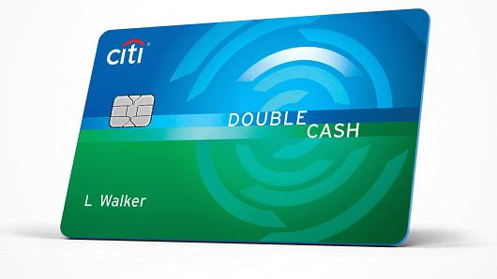
CITI DOUBLE CASH CARD
This a REWARD CARD
0% Intro APR on Balance Transfers and Purchases for 15 months. After that, the variable APR will be 12.99%-22.99%, based on your creditworthiness*
There is a balance transfer fee of either $5 or 3% of the amount of each transfer, whichever is greater
The only card that earns you cash back twice on every purchase with:
1% cash back when you buy
Plus 1% cash back as you pay for those purchases, whether you pay in full or over time*
No Category Restrictions, No Caps, No Enrollments in Rotating Categories
No Annual Fee

Slide 9
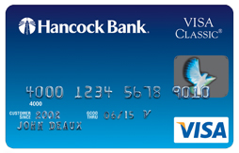
Hancock Bank Visa Classic
This is BALANCE TRANSFER CARD
Signing Promotion
None
Reward Rate
1.00%
Annual Fee
$0
APR, Variable
Purchase: 12.99%, Variable Cash Advance APR: 18.00%, Variable
Intro APR Promotions
Purchase: 0% for 7 mos Transfer: 1.90% for 12 mos

