Slide 1
Bank Comparison
By Kezia kusi Appouh

Slide 2
Instructions:
Research SIX banks
Find out the information
Save as PDF
Publish to your Website
Here are some research sites to help: -http://www.nerdwallet.com/rates/savings-account/
Or google savings comparison

Slide 3
Bank of America Rewards Money Market
Where is it?
It is from a traditional bank but has online access.
APY .03
Minimum Balance to Open = $25
Fees = no fee if you have a balance of $2,500 or $12 Monthly Fee
Transaction Limit: 6 transactions per month
Why is it good? –It has the highest interest rates of all BOA accounts

Slide 4
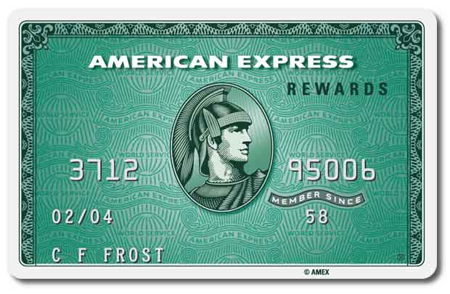
AMERICAN EXPRESS
Traditional bank but has online access.
APY 0.90
Minimum balance to open= 0
Fees =0
Transaction Limit: 6 transactions per month
Why is it good? No monthly fees.

Slide 5
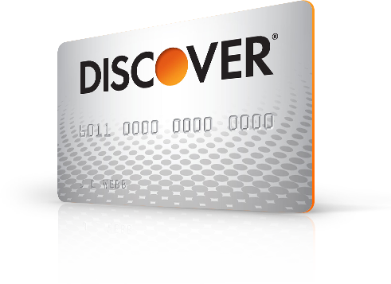
DISCOVER
National bank but has online access.
APY 0.095
Minimum balance to open: $500
Fees:0
Transaction limit: 6 transactions per month
Why is it good? No annual fee.

Slide 6
CAPITAL ONE
National bank and online access
APY 0.75
Minimum balance to open: 0.1
Fees: 0
Transaction limit: 6 transactions per month
Why is it good? You do not have to pay to open an account.

Slide 7
SYNCHRONY BANK
Traditional back and has online access
Minimum deposit of $30 to open requirement to avoid a $5 monthly service charge
Fees may reduce earnings.
APY 1.05
limited electronic and telephone transactions. There is a $20 fee for every withdrawal over six.

Slide 8
NATIONWIDE BANK
It is a traditional bank with online access
APY 0.30
Minimum balance to open: $1
Fees: No monthly maintenance fee when you maintain a minimum daily balance of $300 or a monthly direct deposit of $25 or more.
Transaction limit:6 transactions per month
Why is it good? it doesn’t charge you fees unless you don’t have an active account or maintain a minimum daily balance

Slide 9
WELLS FARGO
National bank but has online access.
APY 0.01
Minimum balance to open : $10
Fees 0
Transaction limit: 6 transactions per month
Why is it good? They do not charge you any fees.

